Slide 1
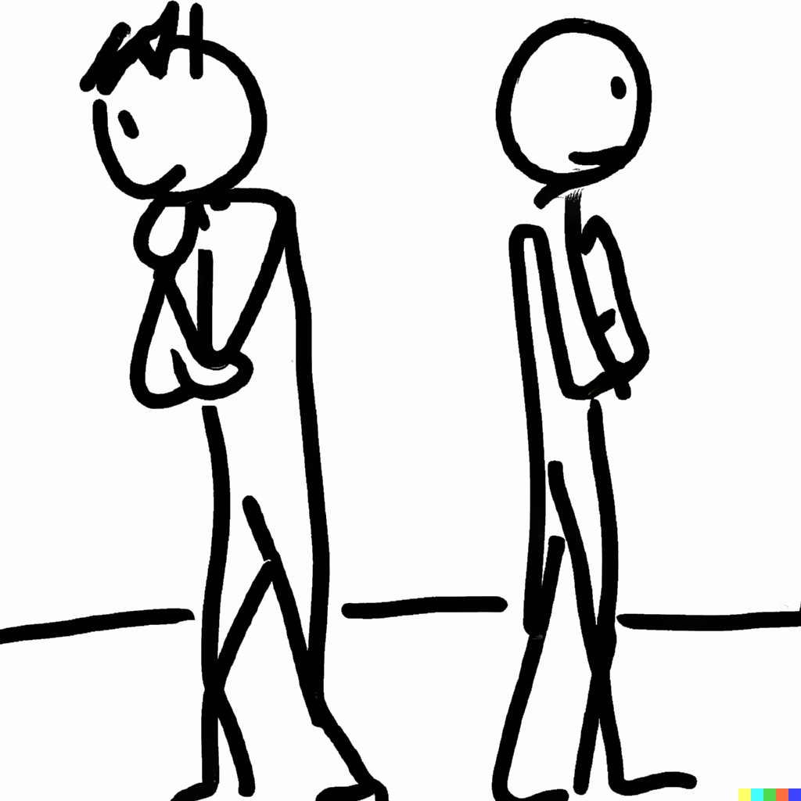
Asymmetric information and the curse of knowledge
Notes on Behavioural Economics
Jason Collins

Slide 2
Behaviour with asymmetric information
People under-estimate the extent to which informational differences drive others’ behaviour.
Better informed agents can fail to take advantage of their informational advantage against less informed agents.

Slide 3


Slide 4
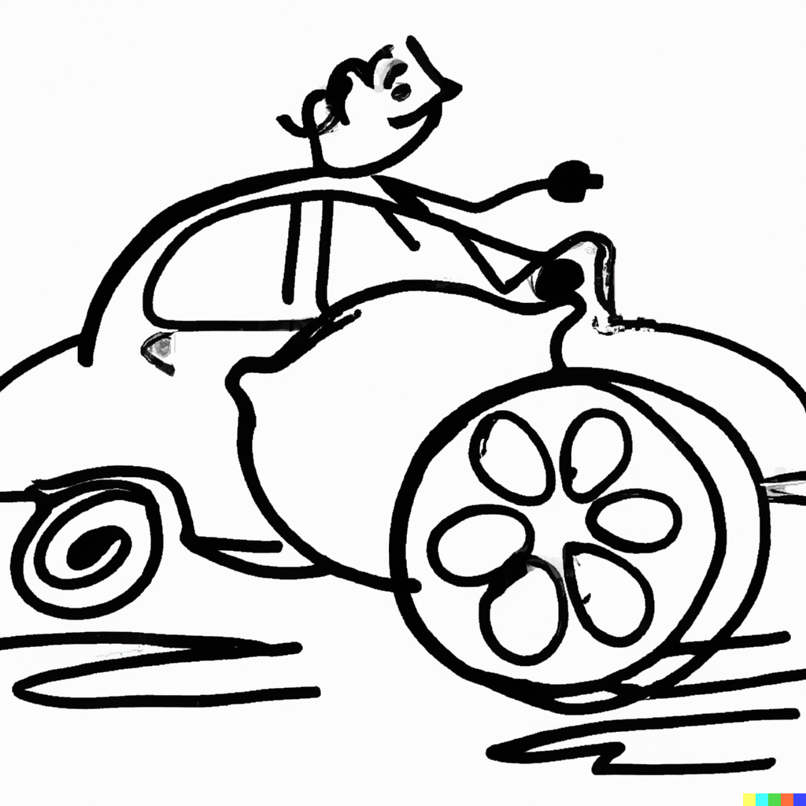

Slide 5
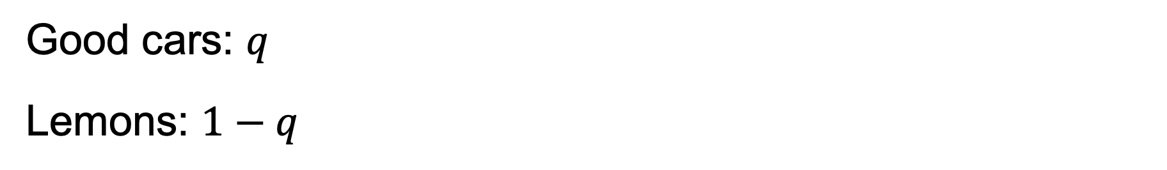
The market for lemons
Good cars: $q$
Lemons: $1−q$

Slide 6
Seller
Good cars: $10,000
Lemons: $5,000
Buyer:
Good cars: $15,000
Lemons: $7,500

Slide 7
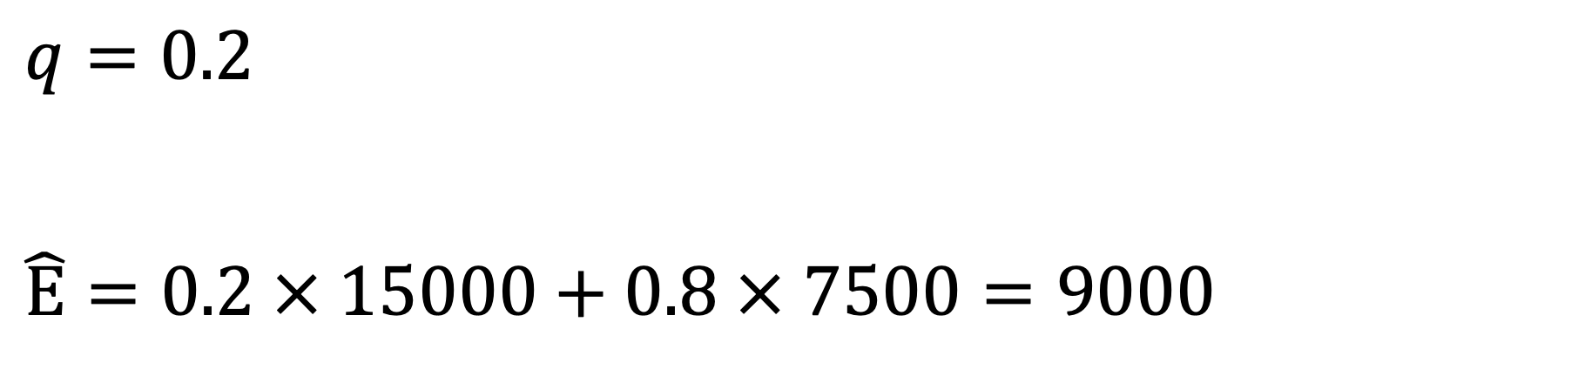
$$q=0.2$$
$$\hat{E}=0.2 × 15000+0.8 × 7500=9000$$

Slide 8


Slide 9
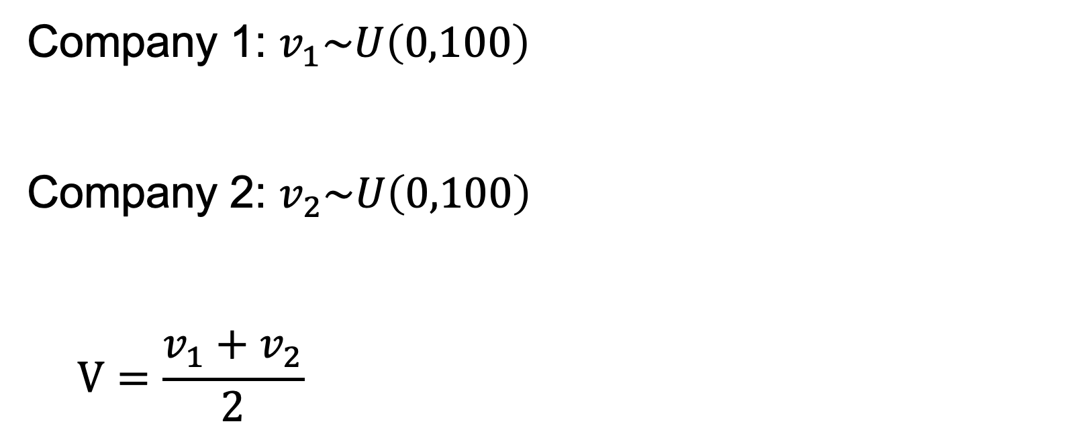
Company 1: $v_{1}\sim U\left(0,100\right)$
Company 2: $v_{2}\sim U\left(0,100\right)$
$$V=\frac{v_{1}+v_{2}}{2}$$

Slide 10
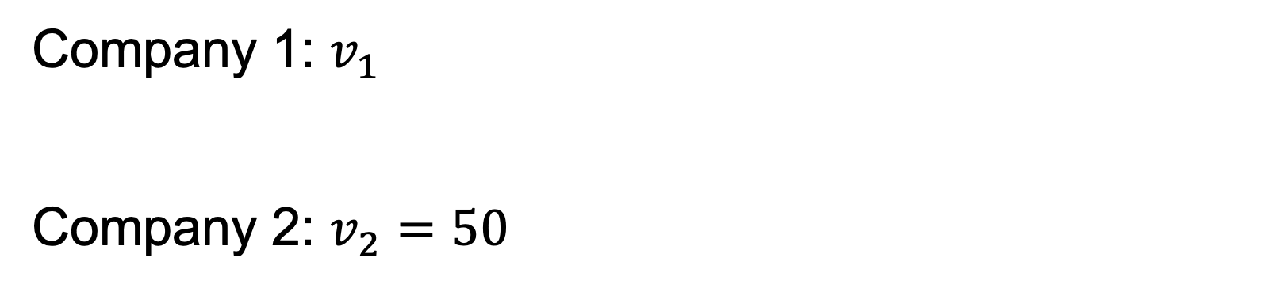
Company 1: $v_{1}$
Company 2: $v_{2}=50$

Slide 11
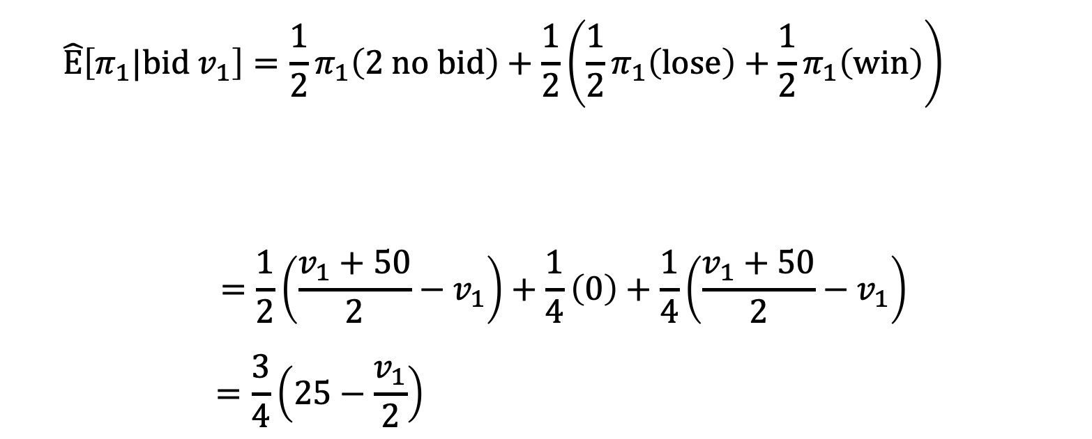
$$\hat{E}\left[π_{1}|bid v_{1}\right]=\frac{1}{2}π_{1}\left(2 no bid\right)+\frac{1}{2}\left(\frac{1}{2}π_{1}\left(lose\right)+\frac{1}{2}π_{1}\left(win\right)\right)$$
$$=\frac{1}{2}\left(\frac{v_{1}+50}{2}−v_{1}\right)+\frac{1}{4}\left(0\right)+\frac{1}{4}\left(\frac{v_{1}+50}{2}−v_{1}\right)$$
$$=\frac{3}{4}\left(25−\frac{v_{1}}{2}\right)$$
Company 2 does not bid
Company 2 bids

Slide 12
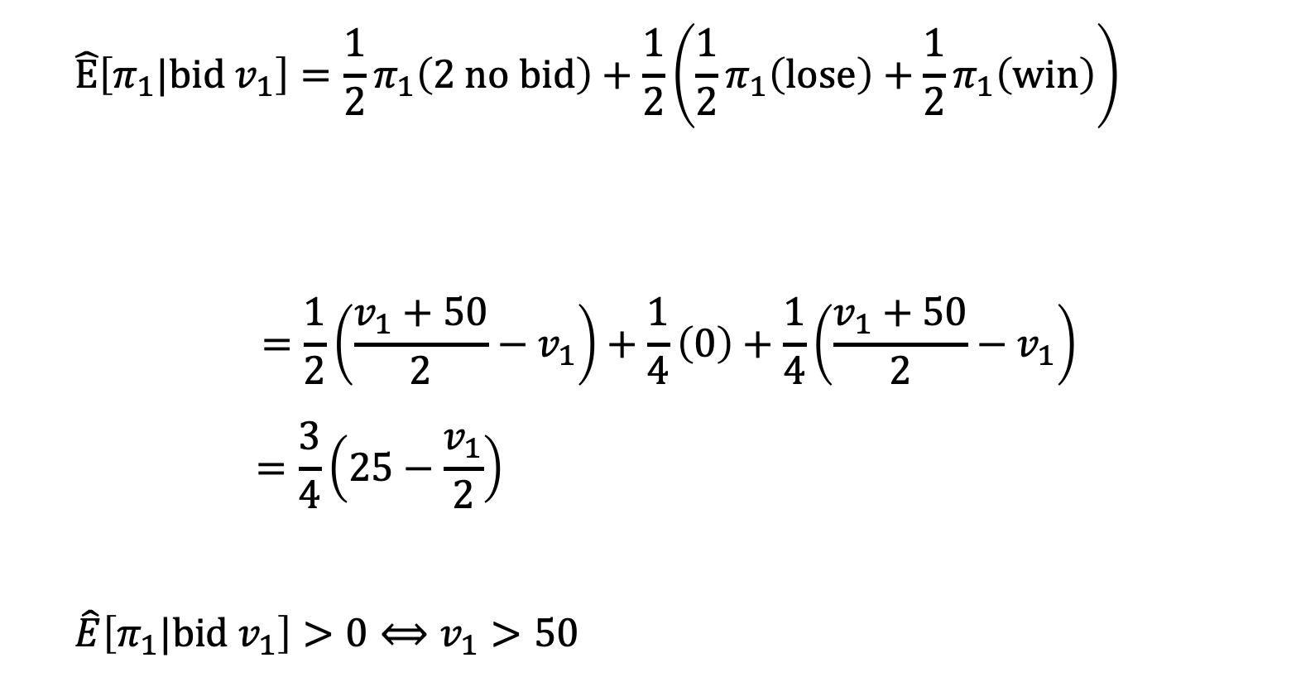
$$\hat{E}\left[π_{1}|bid v_{1}\right]=\frac{1}{2}π_{1}\left(2 no bid\right)+\frac{1}{2}\left(\frac{1}{2}π_{1}\left(lose\right)+\frac{1}{2}π_{1}\left(win\right)\right)$$
$$=\frac{1}{2}\left(\frac{v_{1}+50}{2}−v_{1}\right)+\frac{1}{4}\left(0\right)+\frac{1}{4}\left(\frac{v_{1}+50}{2}−v_{1}\right)$$
$$=\frac{3}{4}\left(25−\frac{v_{1}}{2}\right)$$
$$\hat{E}\left[π_{1}|bid v_{1}\right]>0⟺v_{1}>50$$
Company 2 does not bid
Company 2 bids

